Slide 1
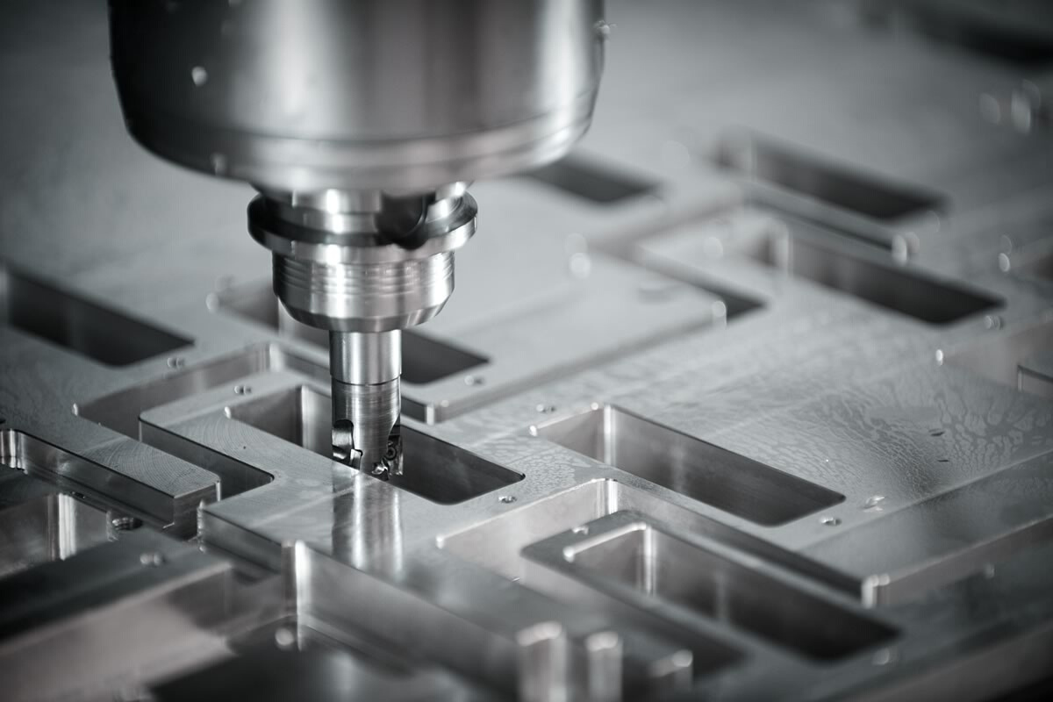
LTI CAMPUS INTERN
TOOL STATE CLASSIFICATION USING MACHINE LEARNING AND DEEP LEARNING ALGORITHMS
Mentors:
Ajesh Rajan, Rahmatullah Zacki
Performed By:
Nikhil Kumar

Slide 2
Outline
INTRODUCTION
OBJECTIVE
DATASET AND DESCRIPTION
DATA PREPROCESSING
FEATURE SELECTION
FEATURE CREATION AND SCALING
DATA DIVISION
CROSS VALIDATION
HYPERPARAMETER TUNING
LEARNING MODELS
EVALUATION
DEPLOYMENT
SOFTWARE AND FRAMEWORKS USED
CONCLUSION

Slide 3
INTRODUCTION
What is Machine Learning?
Application of AI which provides systems an ability to automatically learn and improve from experience without being explicitly programmed.
Tool condition monitoring has become an essential industry phenomenon to achieve high-quality machine operation and cost management.
This method monitors the performance and condition of equipment during normal operation to reduce the likelihood of failures

Slide 4
OBJECTIVE
The objective of this use-case is to develop an algorithm that will classify if the tool will wear out or not given raw machine inputs.
We use the concept of machine learning and deep learning to classify whether the tool will wear out or not using the raw machine data. Using raw data as input to predict the tool state eases out any statistical calculation or filtering for the machine operators.
Here we present machine learning approaches for classifying the Tool state and integrate the most successful approaches into the experimental workflow.

Slide 5
DATASET AND DESCRIPTION
A series of 18 experiments were conducted whose time series data was
collected. The Experiments were conducted on a CNC machine to
create a wax structure. This Experiments were done at the smart lab of
University of Michigan.
The dataset consisted of 25,286 instances of 51 features.
The features were the measurement of velocity, acceleration, position, voltage, current, power, position taken by sensors attached to X,Y,Z and spindle axes and also features like feed rate, pressure, material, process step and tool condition.

Slide 6
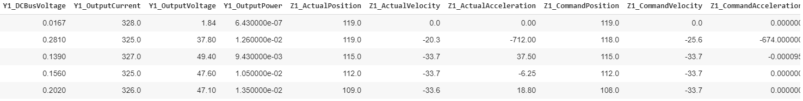
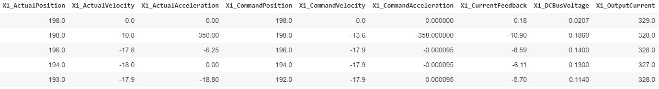
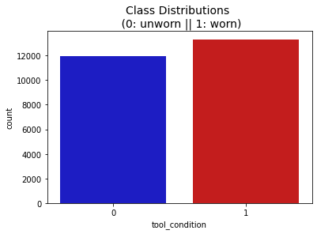
DATASET AND DESCRIPTION
A balanced Dataset

Slide 7

DATA PREPROCESSING
In this step the data gets transformed, or Encoded, to bring it to such a state that now the machine can easily parse it. In other words, the features of the data can now be easily interpreted by the algorithm.
Replacing Null values
Categorical data to Numerical data
Dimensionality Reduction using PCA

Slide 8
DATA PRE-PROCESSING
Why is Data Pre-processing important?
Features which have less null values are imputed using interpolation or mean, median values to create a consistent model. Features are dropped if high number of values are missing.
Categorical Data cannot be understood by computer so it is necessary to convert it to numerical form.
Data analysis tasks become significantly harder as the dimensionality of the data increases. As the dimensionality increases, the number planes occupied by the data increases thus the data becomes difficult to model and visualize.

Slide 9
FEATURE SELECTION
In feature selection we select those features which contribute most to the target variable and remove those features which affects negatively to the model performance.
Selection on the basis of standard deviation
Selecting values on the basis of Correlation matrix values
Selection using library functions

Slide 10
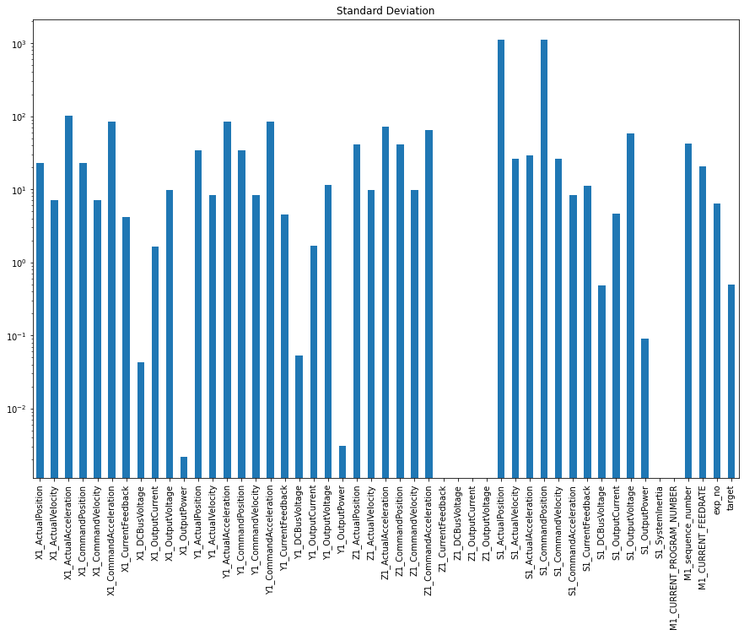
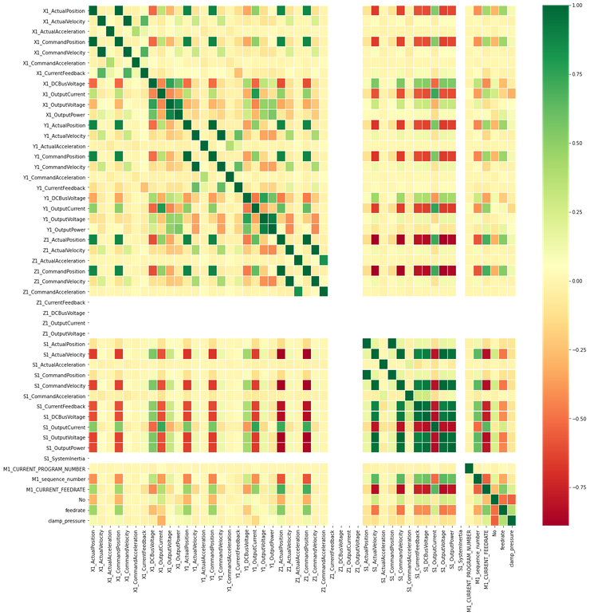
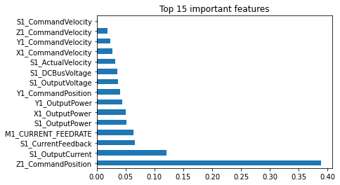
FEATURE IMPORTANCE DISTRIBUTIONS
SD
CORRELATION
FEATURE IMP.
Based on the standard deviation we choose features. The features who are constant or nearly constant are ignored
It tells us how features are related to the target. Correlation values are both positive and negative
Feature importance gives us a score for each feature of your data

Slide 11
FEATURE SELECTION
Why is Data Feature selection important?
Feature selection hugely impacts the performance of the model. So the irrelevant features should be removed so that the performance of model is least affected.
It helps in improving accuracy.
It reduces overfitting because the model is not being trained on noisy data.
It reduces model training time.

Slide 12
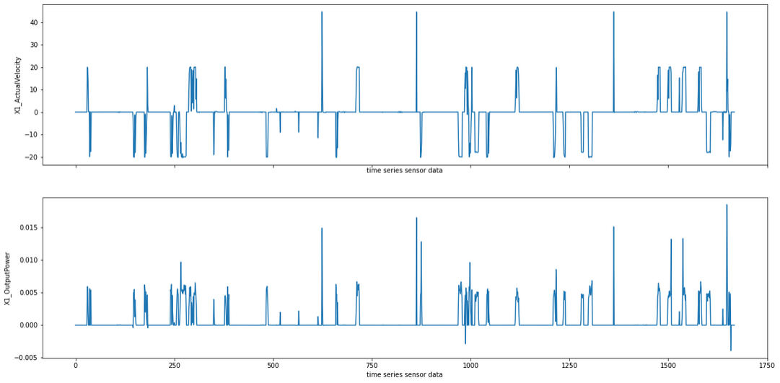
FEATURE CREATION AND SCALING
Feature creation is a step which is performed for a dataset or certain series if the features contain high amount of noise. Noisy data are inaccurate and are caused mainly due to human errors.
We used two methods to remove noise and smooth the data.
Sliding window average mean
Exponential forecast data smoothing method

Slide 13
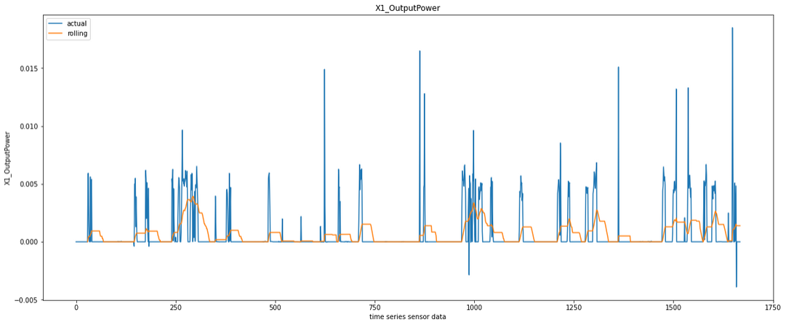
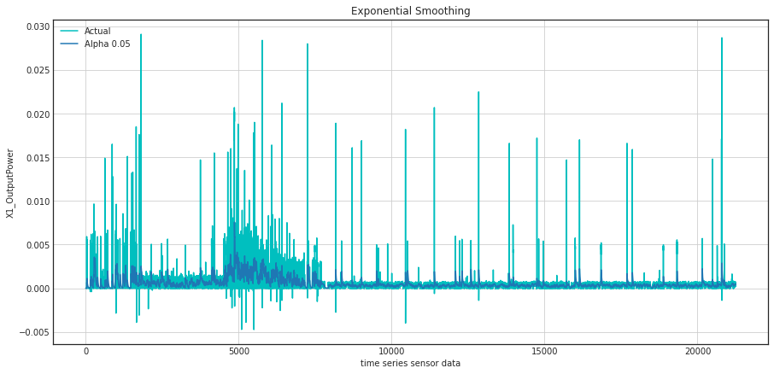
FEATURE CREATION AND SCALING
Running Mean helps to determine the
underlying trend in a feature of the data.
A running mean is an average for a window
of data, where the window is a series of
sequential values from the data.
Exponential smoothing is a technique for smoothing data using the exponential window function. Here the exponential smoothing function acts as a low pass filter.

Slide 14
FEATURE CREATION AND SCALING
Feature Scaling is a normalization technique to convert the data such that it lies within a range using min-max scaling method or deviating the data assuming it is centered at 0 by standard scaler method.
Why are feature creation and scaling important?
Feature creation removes the noise which if left will let the model to learn the noise as a pattern and thereby decrease model accuracy.
Feature scaling speeds up the algorithm calculations.

Slide 15
DATA DIVISION
We split the data as a training set and testing set. We used two methods to split the dataset.
Clubbing all experiments and use 20% data for testing and other for training purpose.
Creating all possible combination of balanced data based on the experiments. Here the time series feature of the data is exploited to see if the data shows any trend with respect to time.

Slide 16
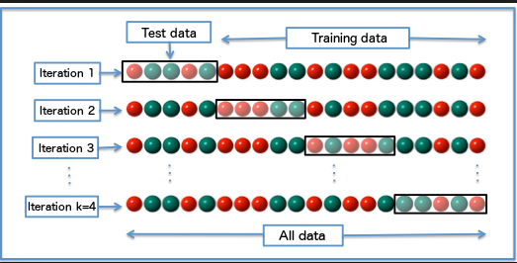
CROSS VALIDATION
We test the model on unseen data to see if the model overfits or underfits. Cross validation helps to train and test the model on entire data by splitting the data in k folds.
Why cross validation?
Cross-Validation helps us to test the effectiveness of our machine learning model. By finding the mean of all K folds we get the best accuracy for our model.

Slide 17
HYPERPARAMETER TUNING
Hyperparameter tuning is a method to choose the best parameters for any model for which the performance of the model is best.
The parameters like n_neighbours, max_depth, learning rate, optimizers, epochs, hidden layers etc. govern the training process of any model and produce a significant impact on the accuracy of the model.
To tune the hyperparameters we used:
Grid Search method
Randomized grid search method
Grid Search method is a brute force method which trains, tests and validates the model for every combination of parameters which are passed and stores the parameters of best performing model.
Randomized search is similar to grid search method but instead of training for every combination it tests for random n combination and it helps to reduce tuning time.

Slide 18
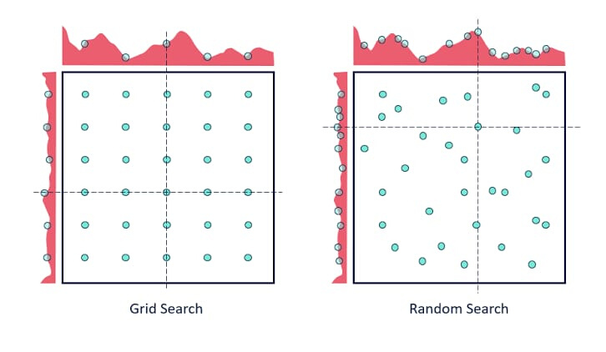
HYPERPARAMETER TUNING
Why Hyperparameter Tuning?
Hyperparameter Tuning is done because a good parameter gives most accurate model and reduces loss.

Slide 19
LEARNING MODELS
We trained and tested our dataset on different machine learning and deep learning models and the models on which our data showed good accuracy are:
Decision Tree Classifier
Random Forest Classifier
XG Boost Classifier
K Nearest Neighbours
Artificial Neural Networks

Slide 20
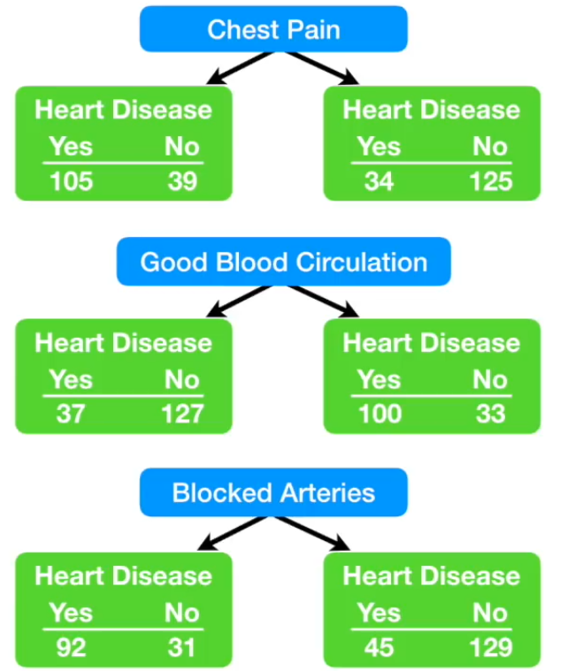
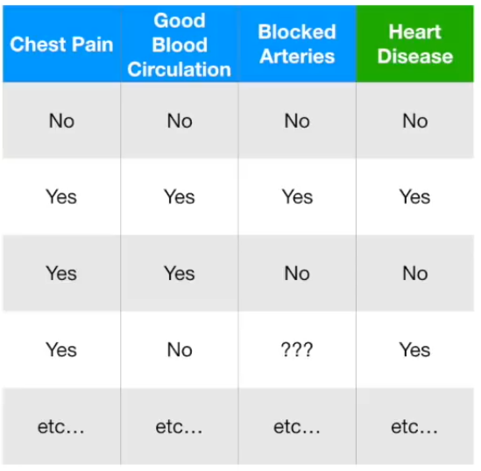
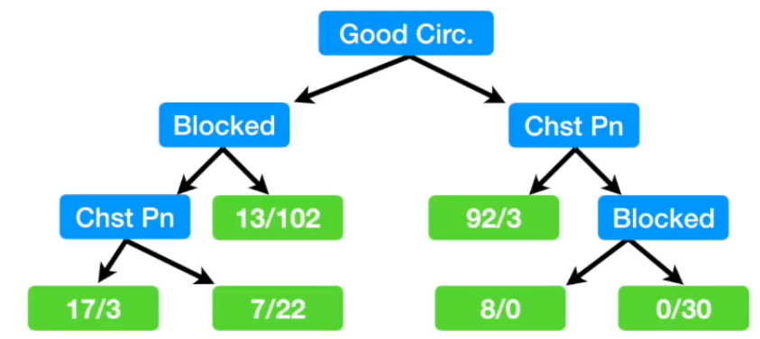
DECISION TREE CLASSIFIER
Decision Tree is like a flowchart tree structure where every node has a decision function and the leaves are the outcomes. Decision Tree takes very less computation time and is faster than Neural Networks. For noisy and unbalanced data the algorithm does not work well so we need to remove noises to improve the model in such cases. The hierarchy of the tree is decided on the basis of entropy.

Slide 21
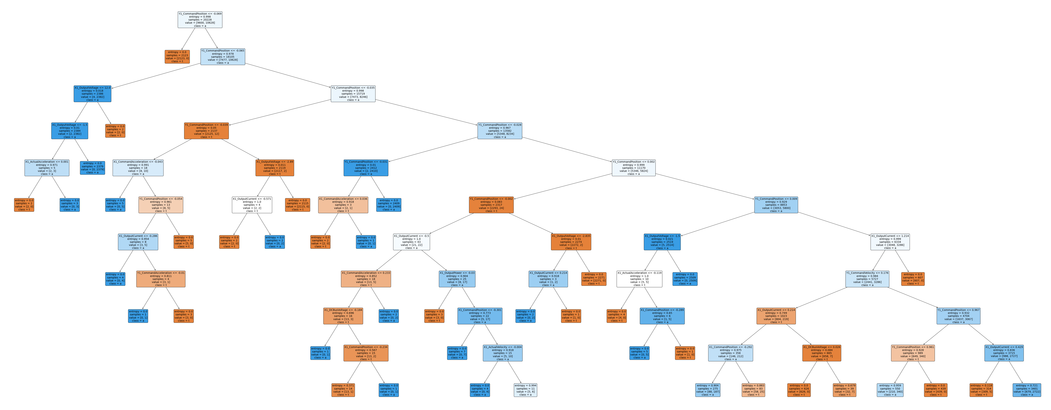
DECISION TREE CLASSIFIER

Slide 22
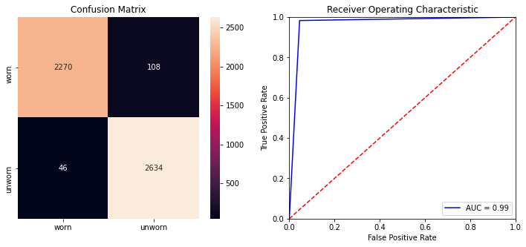
DECISION TREE CLASSIFIER
Training Accuracy: 0.986
Testing Accuracy: 0.969
ROC AUC SCORE: 0.985

Slide 23
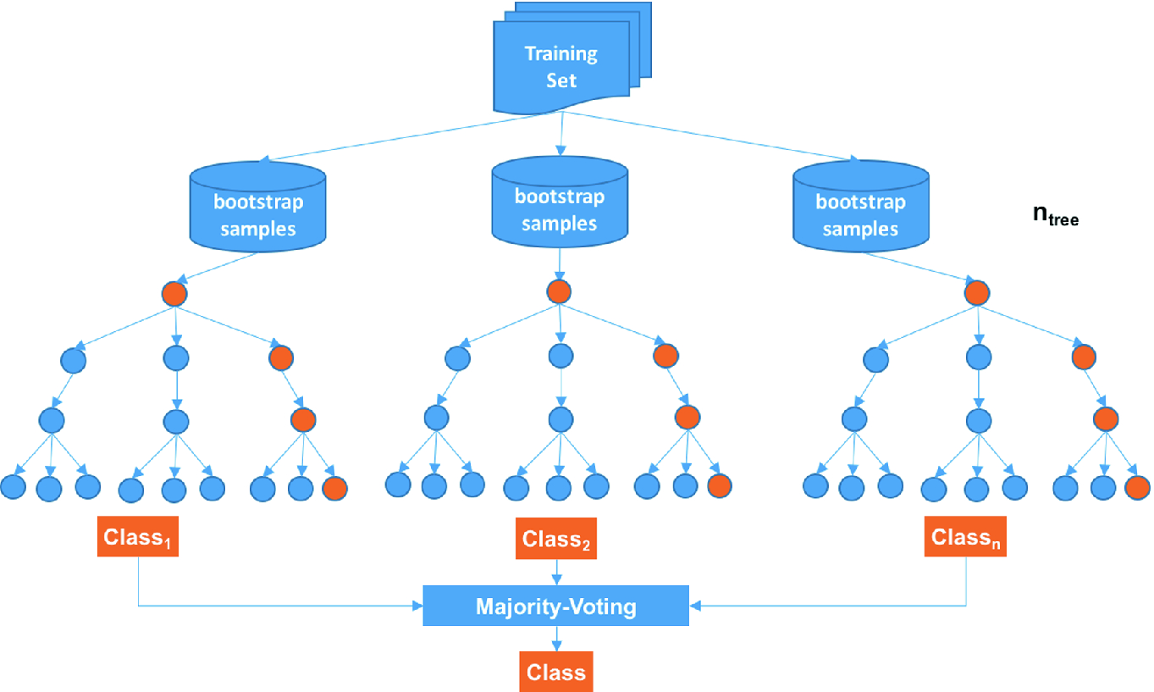
RANDOM FOREST CLASSIFIER
It is an ensemble tree based algorithm. Random Forest classifier is a set of decision trees from randomly selected subset of training set. The trees are voted and the majority voting class decides the final class for the test set. Random forest provides the best accuracy but it takes longer computation time than decision tree, Artificial neural networks and gradient boosting algorithms.
Bootstrap sample of same shape from training set.
Build a decision tree on the sampled data.
Repeat the steps to create n trees.
Check the accuracy on the out of bag data.

Slide 24
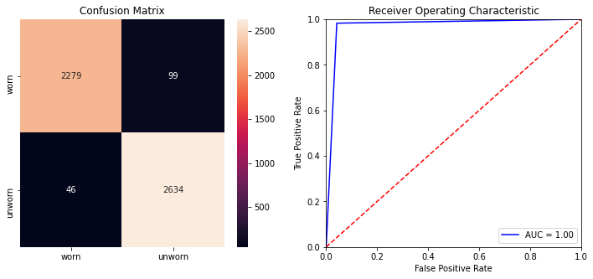
RANDOM FOREST CLASSIFIER
Training Accuracy: 1.0
Testing Accuracy: 0.97
ROC AUC SCORE: 0.99

Slide 25

XG BOOST CLASSIFIER
XG Boost Classifiers use optimized gradient boosting algorithm through parallel processing, tree pruning, handling missing values and regularization to avoid overfitting. It works best for small to medium structured data however it is outperformed by neural nets when large datasets are used.
Training Accuracy: 0.972
Testing Accuracy: 0.969
ROC AUC SCORE: 0.997

Slide 26
K NEAREST NEIGHBOURS
KNN is a non-parametric and lazy learning algorithm i.e; model structure is determined by the dataset and KNN does not needs to be trained for model generation so it makes testing phase slower and consumes high amount of memory. KNN model performs poor at high dimensional dataset as is the case. We normalize the dataset in this case and also tune this algorithm for different hyper-parameters to achieve best estimator.
Randomly select K data values.
Measure the distance of every data from those randomly selected data.
Now based on distance value sort them in ascending order.
Using that order we create the clusters.

Slide 27
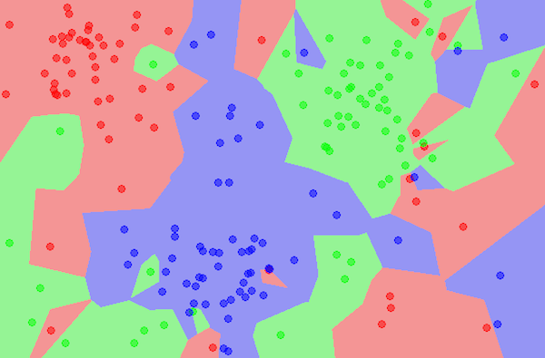
K NEAREST NEIGHBOURS

Slide 28
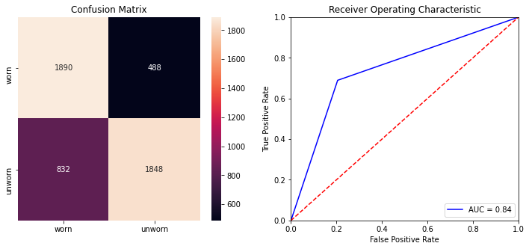
K NEAREST NEIGHBOURS
Training Accuracy: 0.807
Testing Accuracy: 0.735
ROC AUC SCORE: 0.831

Slide 29
ARTIFICIAL NEURAL NETWORKS
Artificial Neural Network consists of an artificial network of functions, called parameters, which allows the computer to learn, and to fine tune itself by analyzing new data. For this model the number of input parameters (34) were more than that of ML models (16).
We created feed forward sequential model using keras library. The network consisted of three dense layers. It took a 2D input of dimension (1, 34) and passed it to next dense layer of 17 nodes through a Relu activation function. The second dense layer passes its input through a function and Relu activation function to next layer of nine nodes which then passes it to the last layer of single node which uses sigmoid function to determine the truth value of the input.
The train and test sets were scaled using standard scaler function so that input feature values implicitly weights all features equally in their representation.

Slide 30
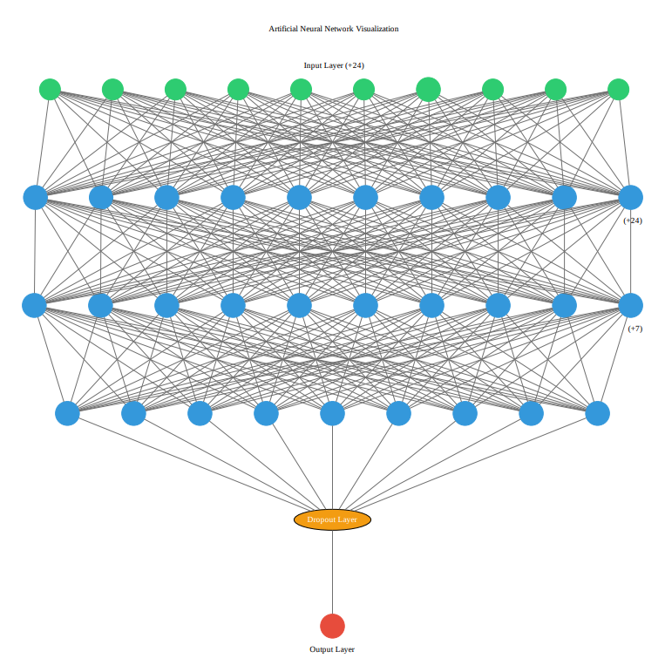
ARTIFICIAL NEURAL NETWORKS
Input vector value
Forward Propagation
Calculate the loss value from cost function
Back-propagation
Nudge the weights and biases according to the loss value
Repeat it according to the epochs

Slide 31

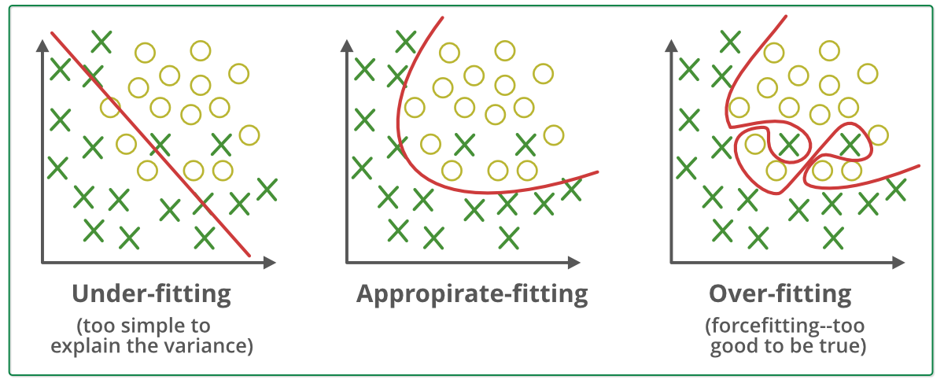
ARTIFICIAL NEURAL NETWORKS
Without Dropout
Training Accuracy: 0.98
Testing Accuracy: 0.92
With Dropout
Training Accuracy: 0.94
Testing Accuracy: 0.93

Slide 32
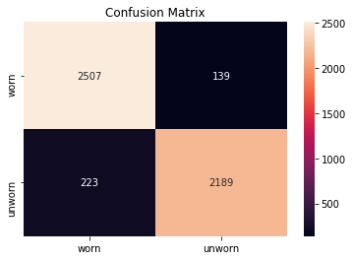
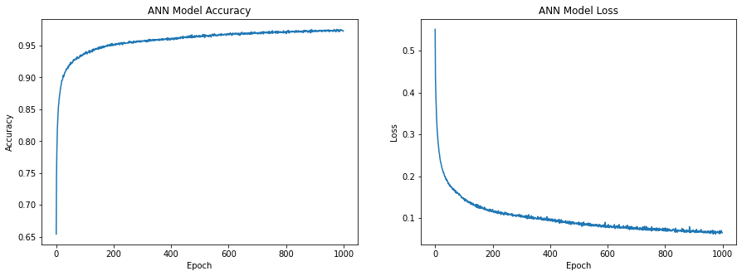
ARTIFICIAL NEURAL NETWORKS
Training Accuracy: 0.94
Testing Accuracy: 0.93

Slide 33
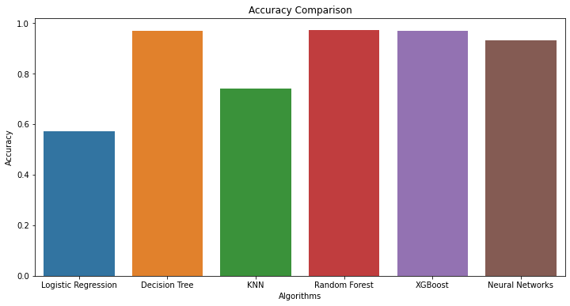
EVALUATION
KNN model under performs as compared to other algorithms because it uses euclidean distances to cluster the data and in the case of high dimension data clustering becomes difficult since most of the vector data become equidistant to the search query vector.
Decision tree performs good in because it grows exponentially for each level and it is easily able to handle medium to high dimensional data.
Similarly random forest and XG boost are uses decision tree as on of the component so they perform good for high dimensional data.
Neural Networks algorithm gives good
accuracy but less than tree algorithms because
it requires high amount of data to train and
choose best weights for it's neurons.

Slide 34
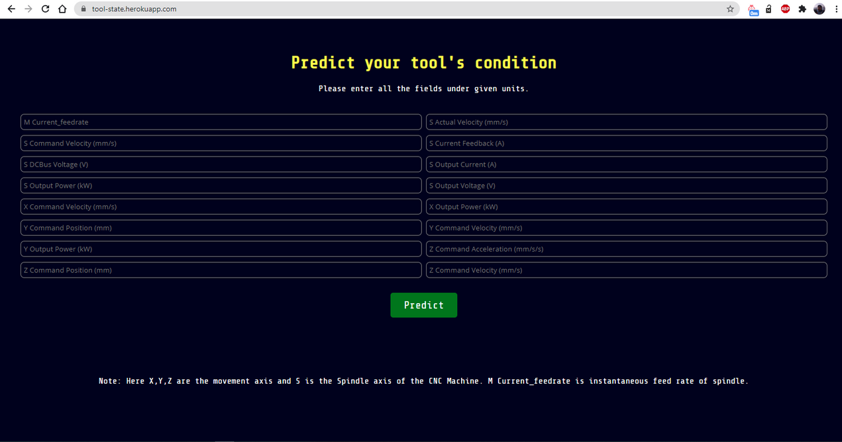
BUILDING API AND WEB-APPLICATION DEPLOYMENT
We choose Random Forest classifier as the prediction model and build an API using Flask. We created a Web-app using HTML and CSS and deployed the website using Heroku web services. The Web app takes 16 raw numerical machine features and predicts the tool state. The Web-App is live at
https://tool-state.herokuapp.com/
Why Random Forest?
Random forest was used as the prediction model because it gave the most accurate result although it is bit slower than other algorithms.

Slide 35
TECHNOLOGY AND FRAMEWORK
I used python language it is a powerful high-level language and I am well versed with it.
I used scikit learn library for the development of Machine Learning models as scikit learn provides many useful libraries and has very good documentation of its tools.
I used Keras library on TensorFlow as Keras is easy to learn and is a very powerful library used for deep learning purposes.
For the data handling, computation, and visualization purposes Pandas, numpy, seaborn, and matplotlib was used.
For the development of API, we used the Flask library and wrote the code in python. Flask is a well-known technology and helps in the creation of robust applications very easily. It also provides good documentation.
The website was written using HTML and styled with CSS. The website is hosted on Heroku because it provides a sufficient amount of memory for free and easy hosting.
I used Google colaboratory as our platform so that we can use it’s fast and free TPU accelerators which decreases model training and testing time to a great extent.

Slide 36
From the above use-case, we determined the important features which affect the tool state. The models were trained on a sufficient amount of data and so the results are reliable and can be used during CNC experiments to protect the cutting tool. The cutting tool is made of high-speed steel or carbides and is therefore very costly. We also determined the accuracy of algorithms and which of them will be most efficient for Web-app creation.
CONCLUSION

